Slide 1
EN 55014-2: 1997
-EFT(IEC 1000-4-4)
-ESD(IEC 1000-4-2)
EMC(GZ) GROUP

Slide 2
Immunity –Product family standard
Introduction:
the intention of the standard is to establish uniform requirements.
refer to basic standards for methods of testing, operating condition, performance criteria and interpretation of results.

Slide 3
Scope: (frequency from 0Hz to 400 GHz)
A. Apply to:
Household and similar purposes that use electricity, as well as electric toys and the rated voltage of the apparatus being not more than 250V for single phase apparatus to be connected to phase and neutral , and 480V for other apparatus.
Apparatus may incorporate motors, heating elements,
may contain electric and electronic circuitry, and may be powered by mains, by batteries, or by any other electrical power source.
Not intended for household use but included in CISPR 14
In addition:
-microwave ovens for domestic use and catering
-cooking hobs and cooking oven,heated by means of r.f energy, induction cooking appliances.
-UV and IR radiators for personal care.

Slide 4
Scope: (frequency from 0Hz to 400 GHz)
B: not apply to:
  Equipment for lighting purposes.
  Apparatus designed exclusively for heavy industrial purposes.
  Apparatus intended to be part of the fixed electrical installation of buildings.
  Apparatus intended to be used in locations where special electromagnetic conditions prevail.
  AV product
  Medical electrical appliances
  Personal computer and similar equipment
  Radio transmitters
  Apparatus designed to be used exclusively in vehicles

Slide 5
Normative references
IEC 50(160):1990
IEC 1000-4-2:1995 ESD
IEC 1000-4-3:1995 RS
IEC 1000-4-4:1995 EFT
IEC 1000-4-5:1995 Surge
IEC 1000-4-6:1996 CS
IEC 1000-4-11:1994 DIPS
CISPR 11:1990 Limits and methods of ISM
CISPR 14:1993
CISPR 16-1:1993

Slide 6
Definition:
Electromagnetic compatibility
Port
Enclosure port
Series production

Slide 7
5 Test:
5.1 ESD
air charge:8KV, contact discharge: 4KV
Note: 20 discharges shall be applied on each accessible metal part of the enclosure.In case of non-conductive enclosure, discharges shall be applied on HCP or VCP.
5.2 EFT
5.2.1 ports for signal lines and control lines(length exceed 3 m)
0.5kV(Peak), 5kHz repetition frequency
5.2.2 Input and out d.c power ports
0.5kV(Peak), 5kHz repetition frequency
note: not applicable to battery operated appliances that cannot be connected to the mains.
5.2.3 Input and output a.c. power ports
1kV(Peak), 5kHz repetition frequency

Slide 8
5 test:
5.3 Injected currents 0.15MHz to 230MHz
5.3.1 ports for signal lines and control lines
(length exceed 3m)
RF current(common mode), 1kHz 80% AM,
0.15MHz to 230MHz, 1V (unmodulated), 150Ω source impedance
5.3.2 Input and out d.c power ports
(can be connected to the mains or d.c. cables exceed 3m)
RF current(common mode), 1kHz 80% AM,
0.15MHz to 230MHz, 1V (unmodulated), 150Ω source impedance
5.3.3 Input and out d.c power ports
RF current(common mode), 1kHz 80% AM,
0.15MHz to 230MHz, 3V (unmodulated), 150Ω source impedance

Slide 9
5 test:
5.4 Injected currents 0.15MHz to 80MHz
same as 5.3 except upper limit 80MHz.
5.5 RF electromagnetic fields, 80MHz to 1000MHz
3V/m (unmodulated)
5.6 Surge
Five positive and five negative pulses
-phase and phase: 1kV
-phase and neutral:1KV
-phase and protective earth:2 kV
-neutral and protective earth: 2kV

Slide 10
5 test:
5.7 Voltage dips and interruptions
voltage dips in %U, 100(0.5T), 60(10T), 30(50T), T=20ms(50Hz)

Slide 11
6 Performance criteria:
Performance criteria A:
Performance criteria B:
Performance criteria C:

Slide 12
7 applicability
a.the tests shall be carried out as single tests in sequence and the sequence of testing is optional.
b.It may be determined from consideration of the electrical characteristics and usage of a particular apparatus that some of the tests are inappropriate, and therefore unnecessary. It is required that the decision not to be tested be recorded in the test report.
c.experimental and construction kits deemed to fulfill the immunity.

Slide 13
7 Application:
 | 5.1 | 5.2 | 5.3 | 5.4 | 5.5 | 5.6 | 5.7
I | ----- | ----- | ----- | ----- | ----- | ----- | -----
II | B | B | A | B | ----- | B | C
III | B | B | A | ----- | ----- | ----- | -----
IV | B | B | ----- | A | A | B | C

Slide 14

ESD IEC 1000-4-2:1995
Typical waveform of the discharge current
Range of test levels
Test equipment
Test set-up
Test procedure

Slide 15
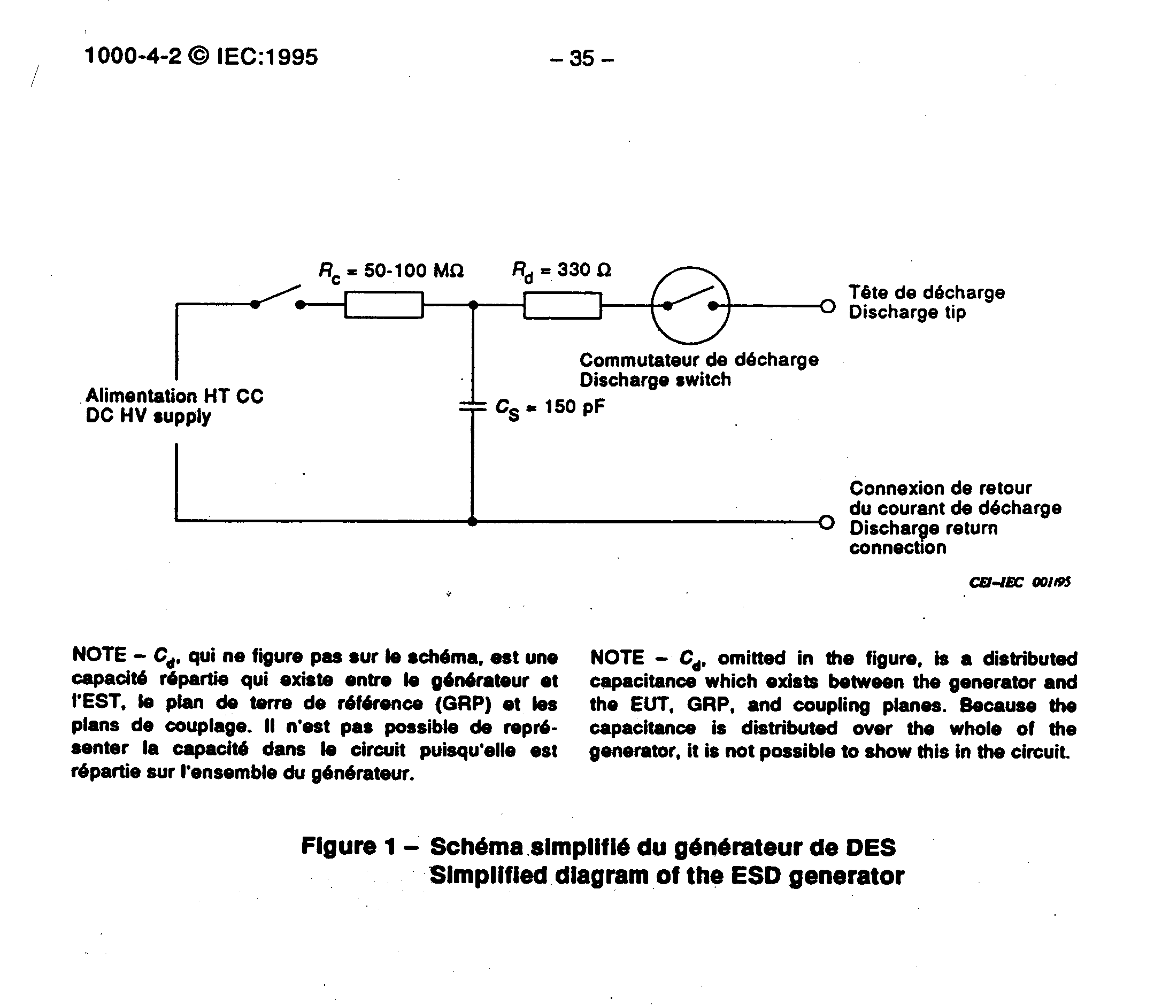
ESD IEC 1000-4-2:1995
Typical waveform of the discharge current

Slide 16
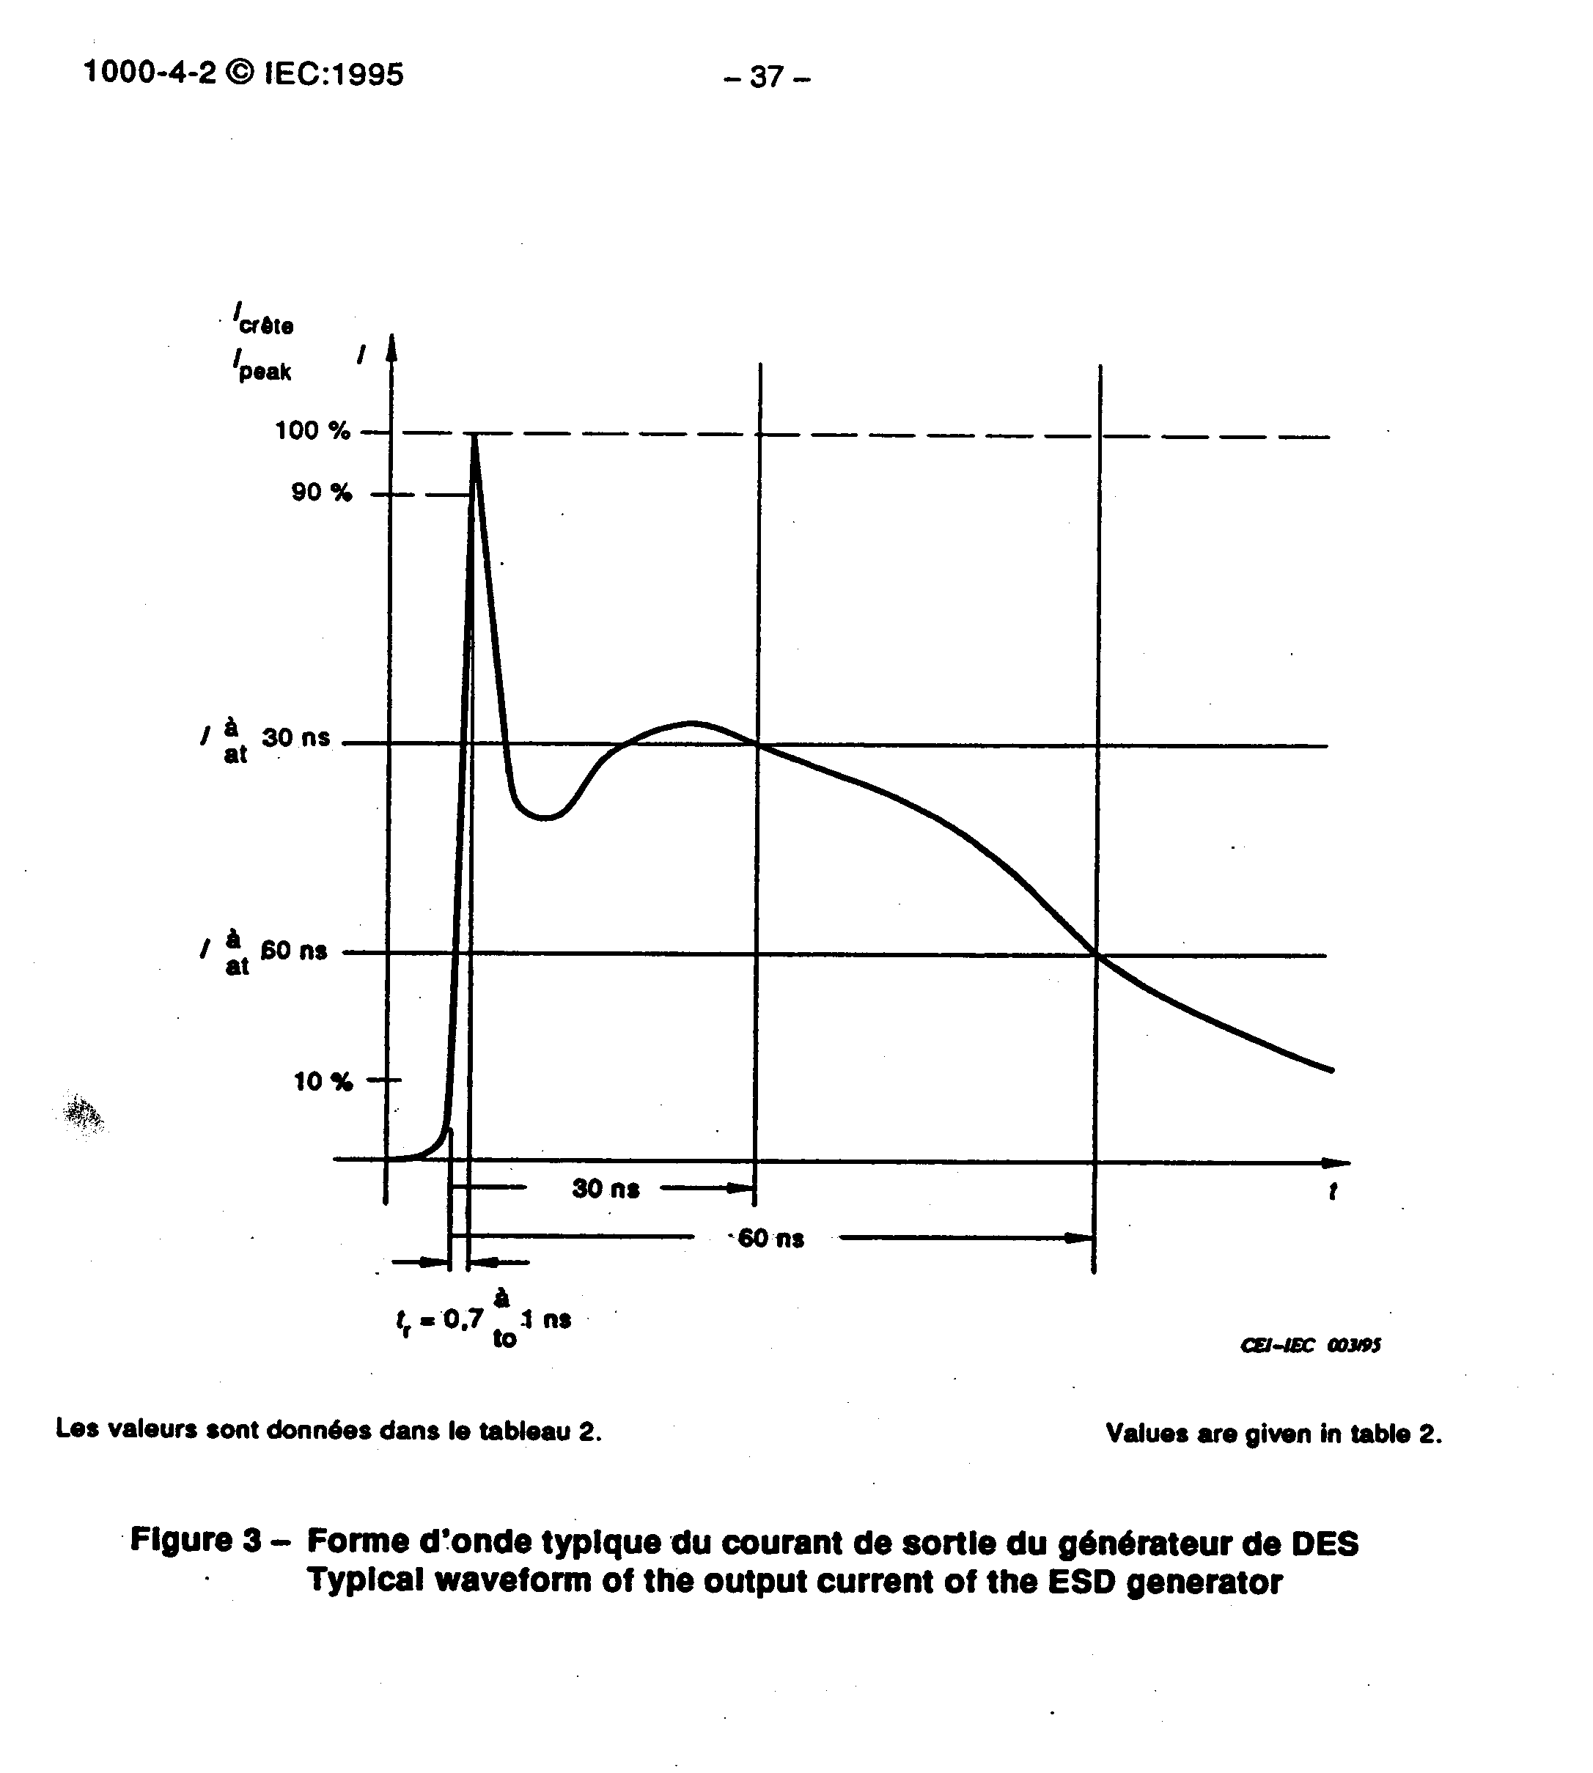
ESD IEC 1000-4-2:1995
Waveform

Slide 17
ESD IEC 1000-4-2:1995
Test set-up
-contact discharge to the conductive surfaces and to coupling planes.
-air discharge at insulating surface.
-type tests performed in laboratories(preferred)
-a ground reference plane shall be provided, its minimum thickness is 0.25mm(copper or aluminium), the minimum size is 1m².
-a distance of 1m minimum between EUT and the wall.
-15ºC to 35ºC, 30% to 60%

Slide 18
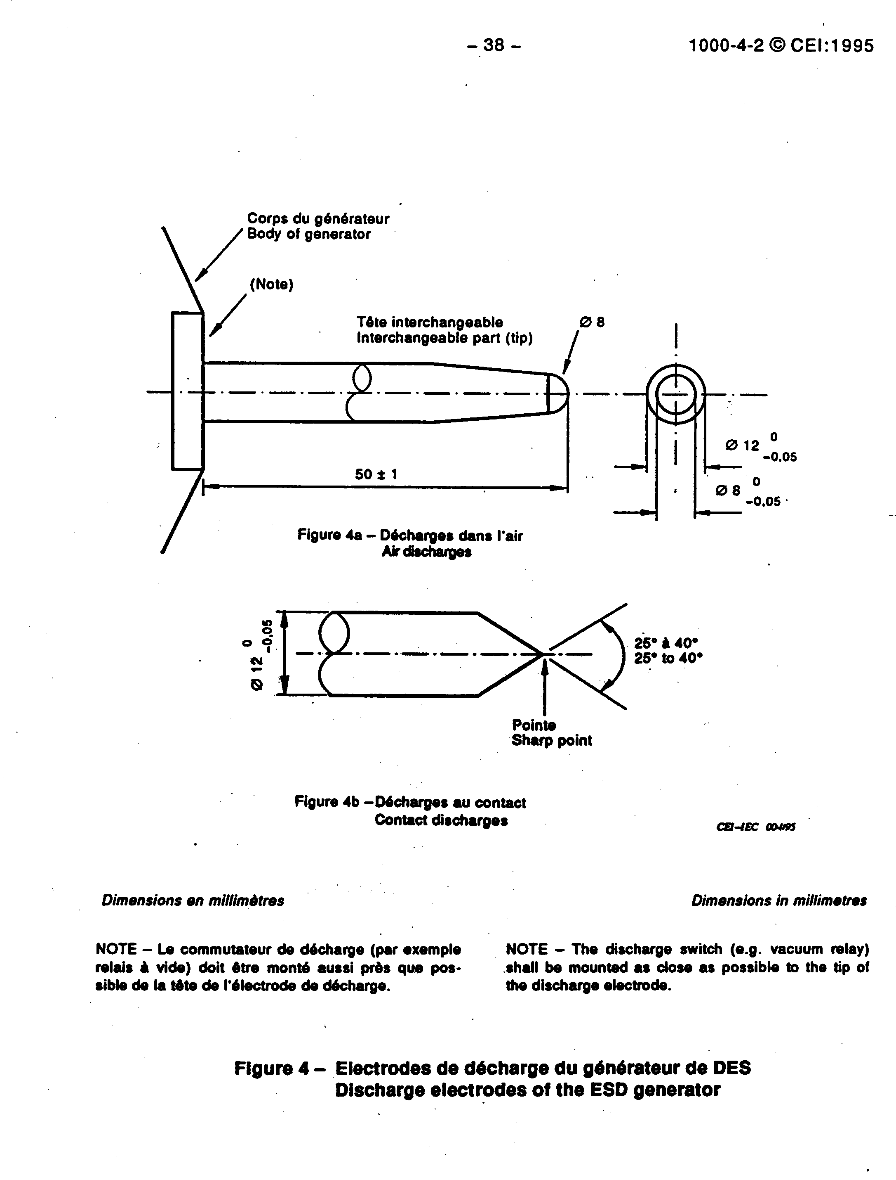
ESD IEC 1000-4-2:1995

Slide 19
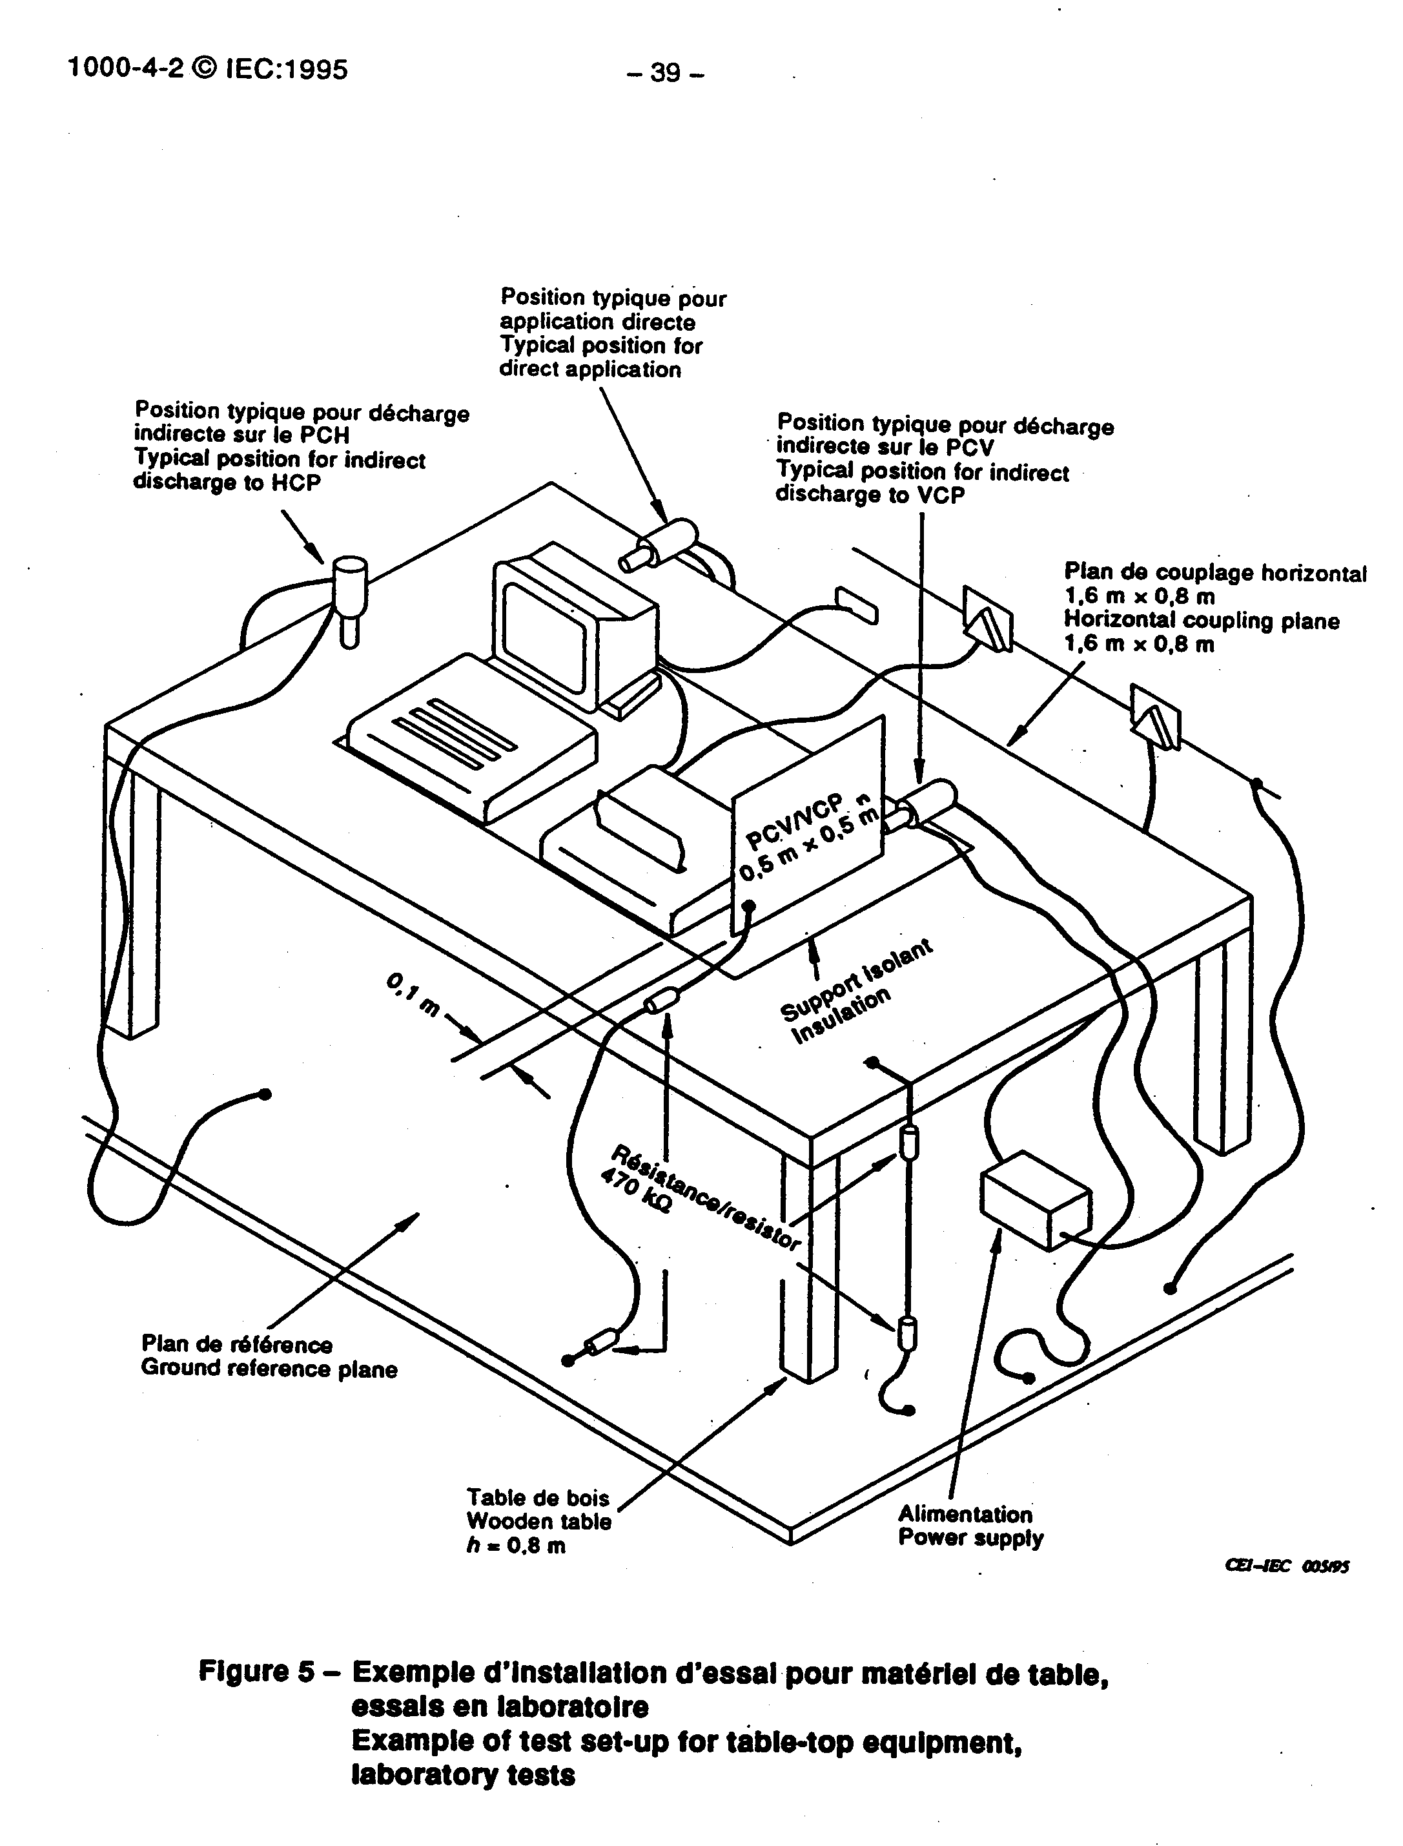
ESD IEC 1000-4-2:1995

Slide 20
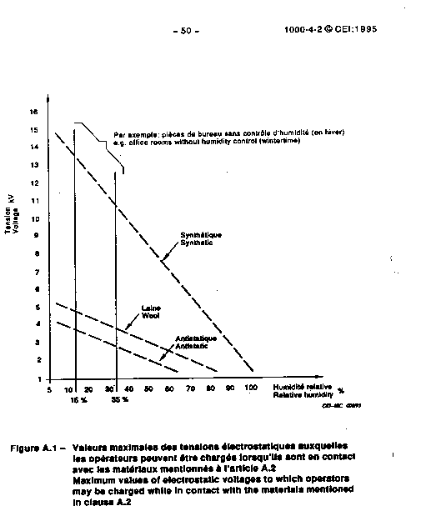
ESD IEC 1000-4-2:1995

Slide 21
ESD IEC 1000-4-2:1995
Selection of test points
-points on metallic sections of a cabinet which are electrically isolated from ground.
-any point in the control or keyboard area and any other point of man-machine communication, such as switches, knob,buttons,and other operator-accessible areas,
-indicators,LEDs,slots,grilles,connector hoods,etc.

Slide 22
EFT IEC 1000-4-4:1995
Typical waveform of the discharge current
Range of test levels
Test equipment
Test set-up
Test procedure

Slide 23
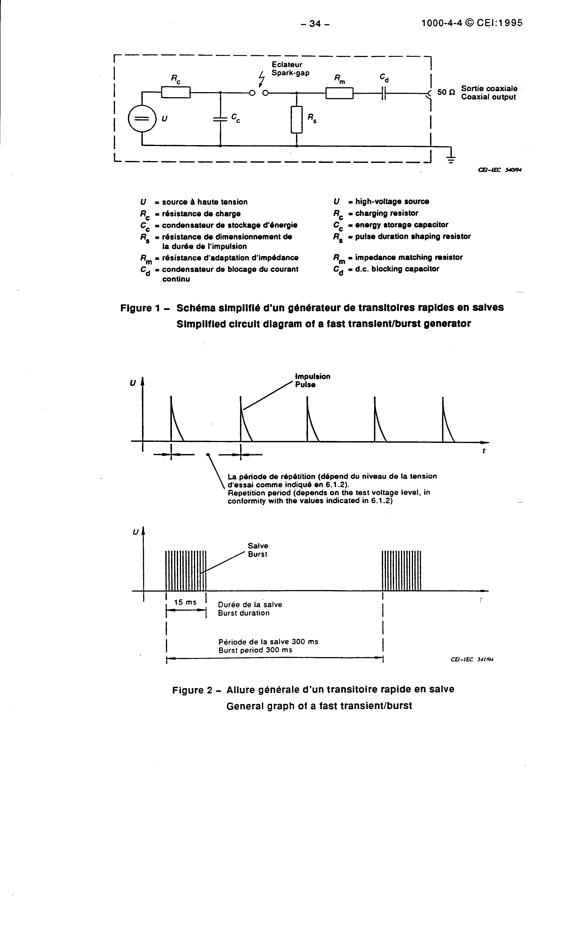
ESD IEC 1000-4-4:1995
Typical waveform of the discharge current

Slide 24
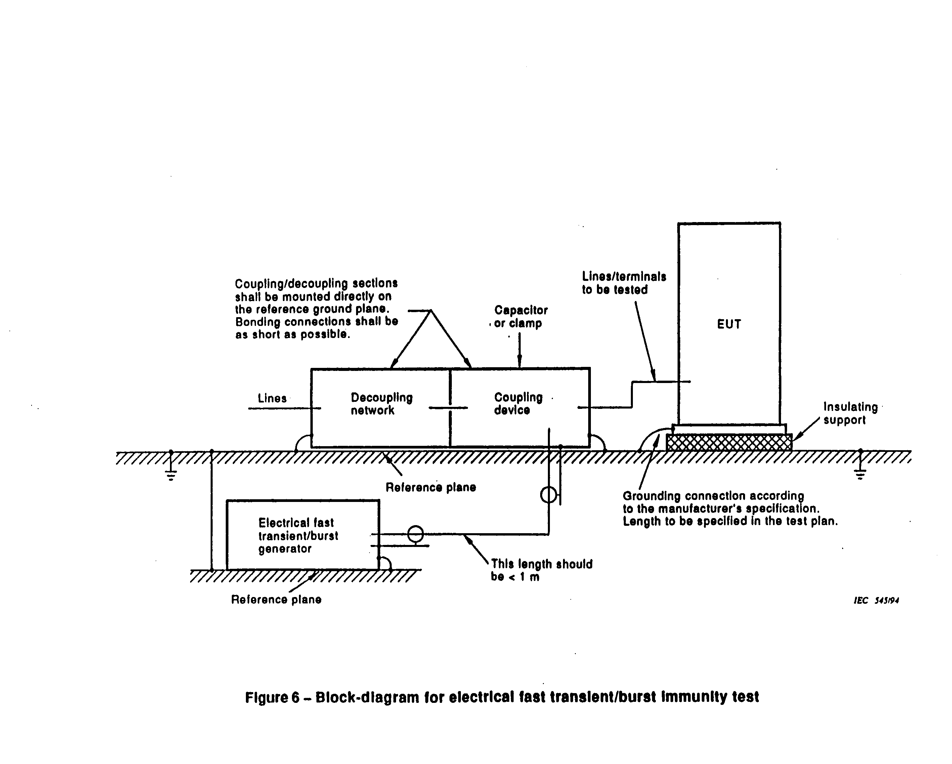
ESD IEC 1000-4-4:1995
Set-up

Slide 25
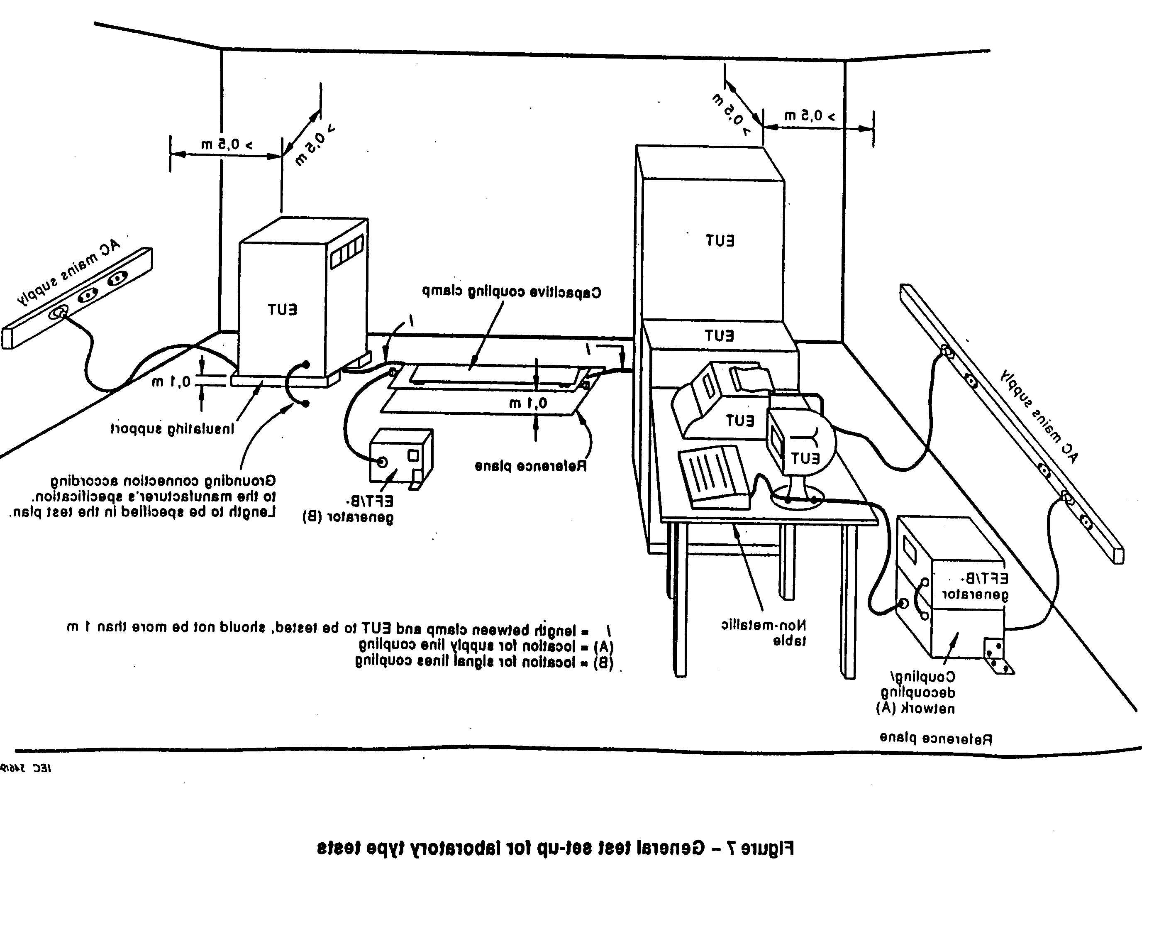
ESD IEC 1000-4-2:1995

Slide 26
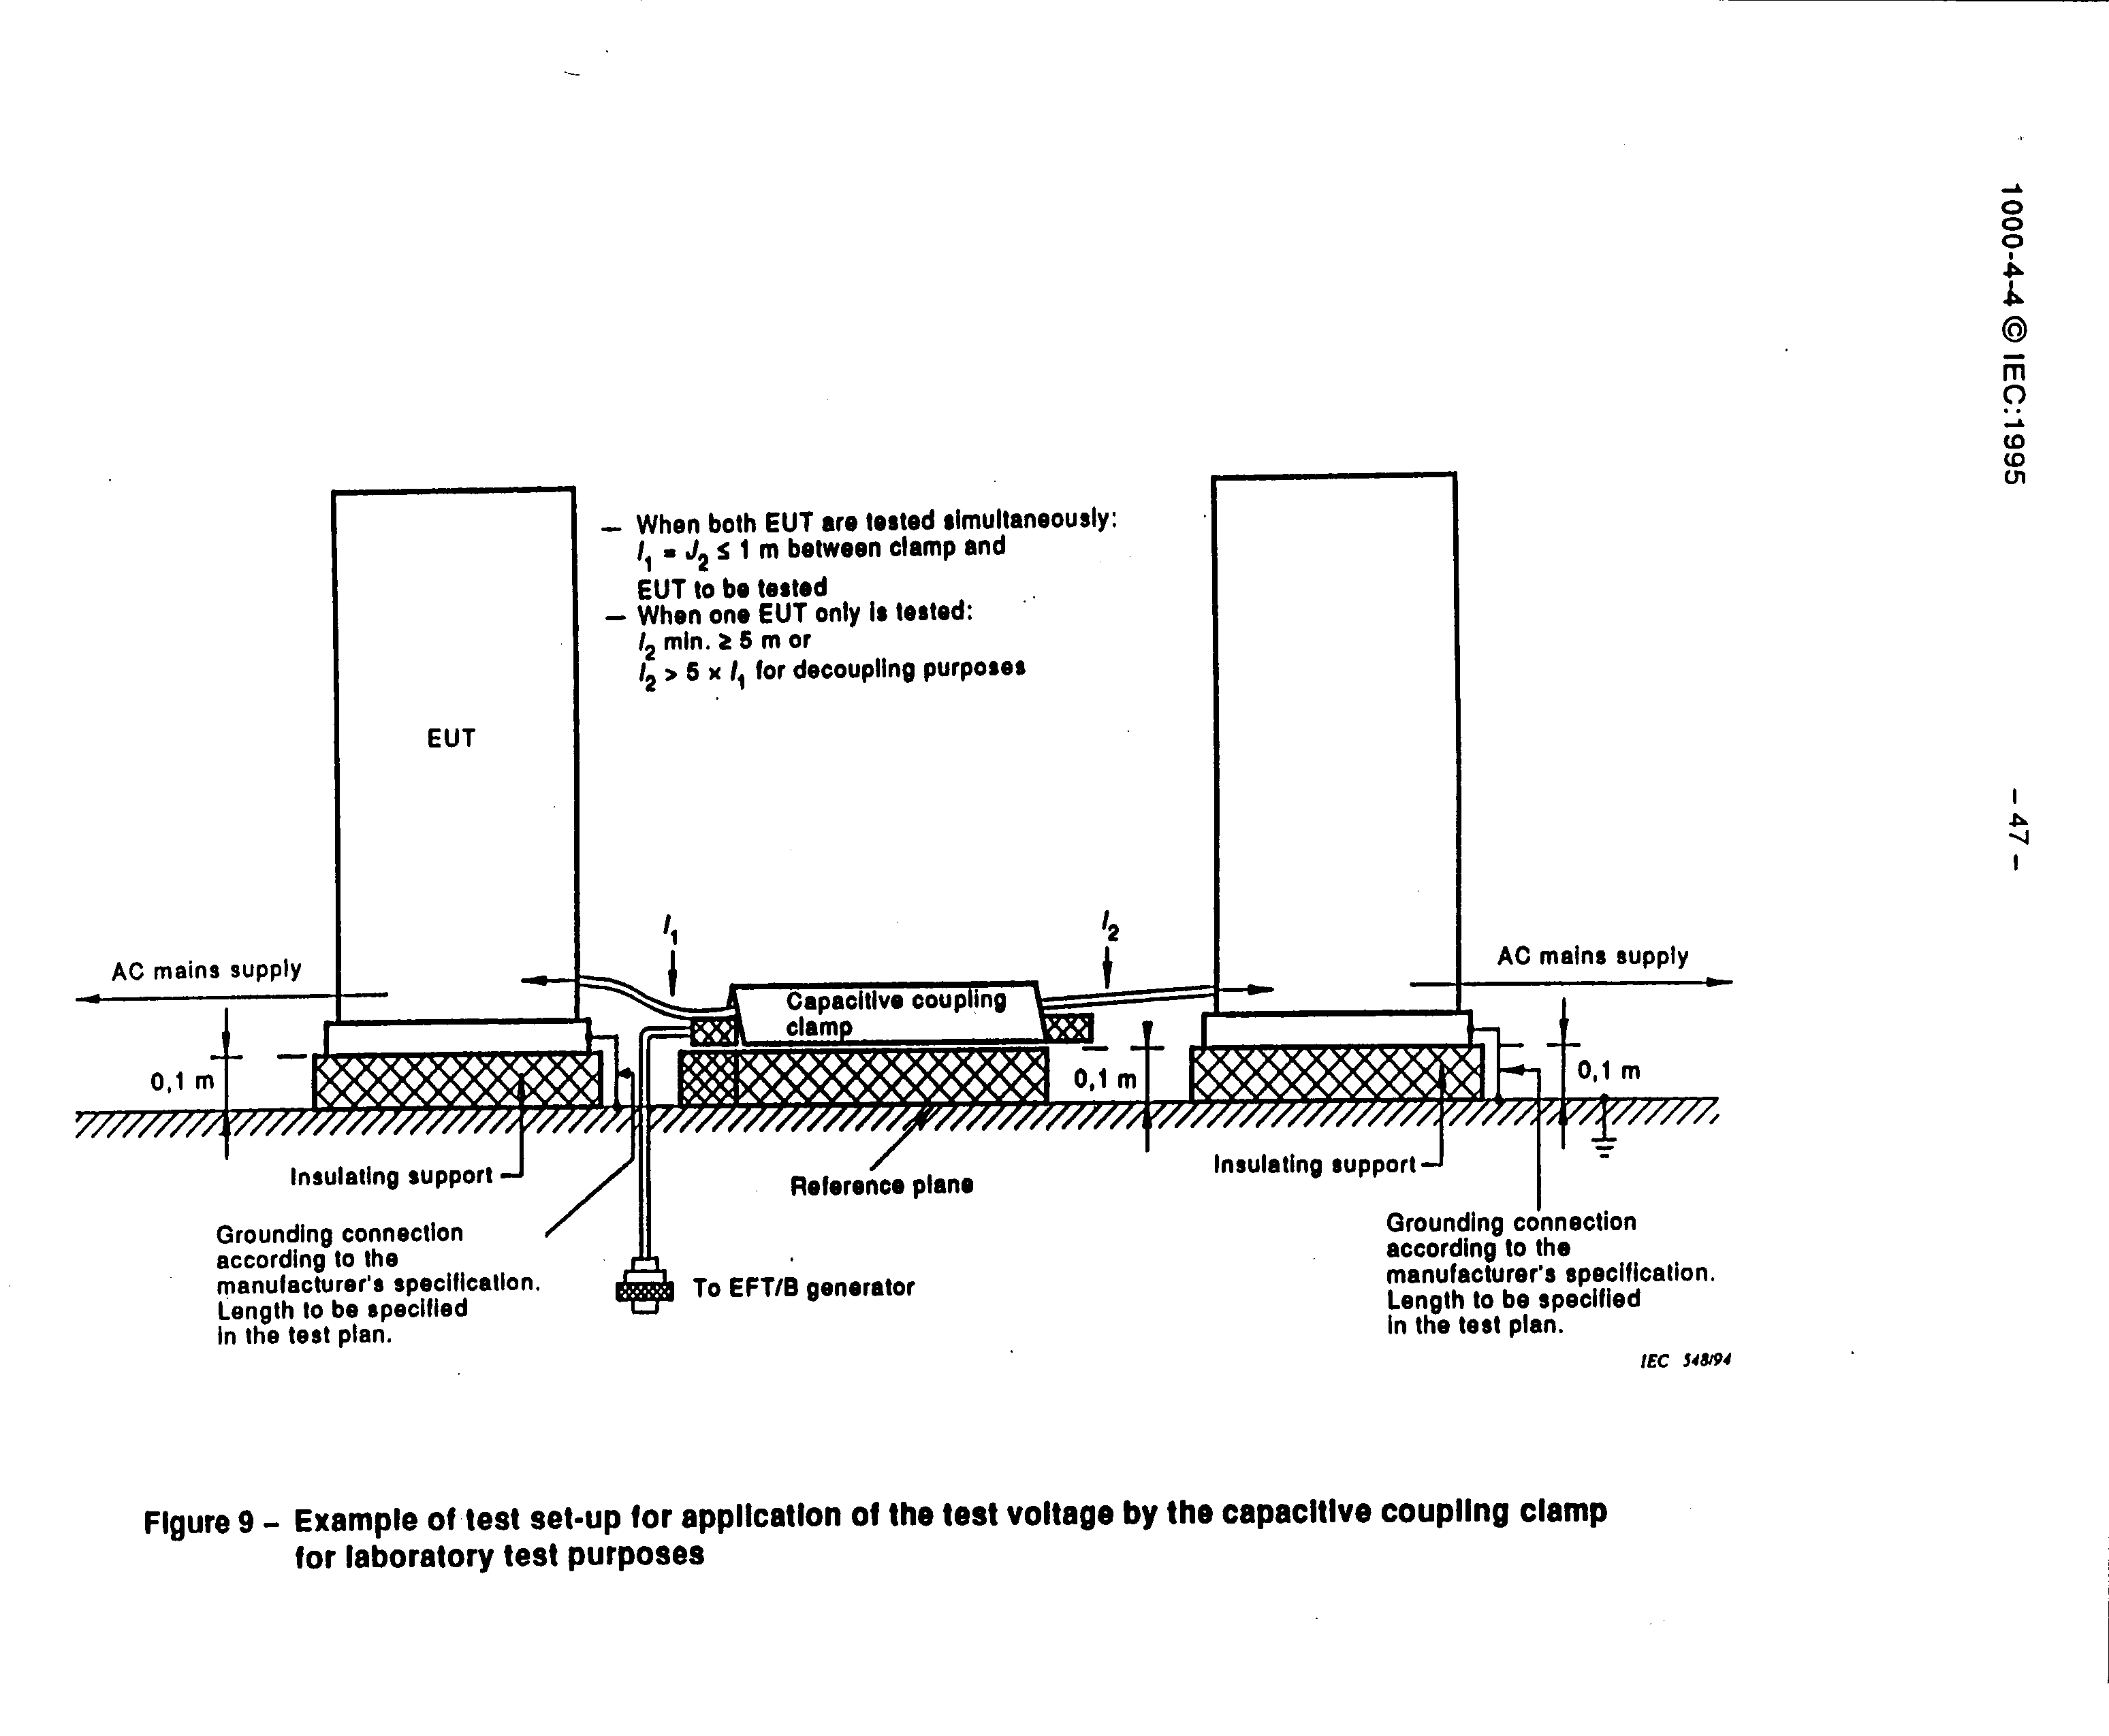
ESD IEC 1000-4-4:1995
Figure 9

Slide 27
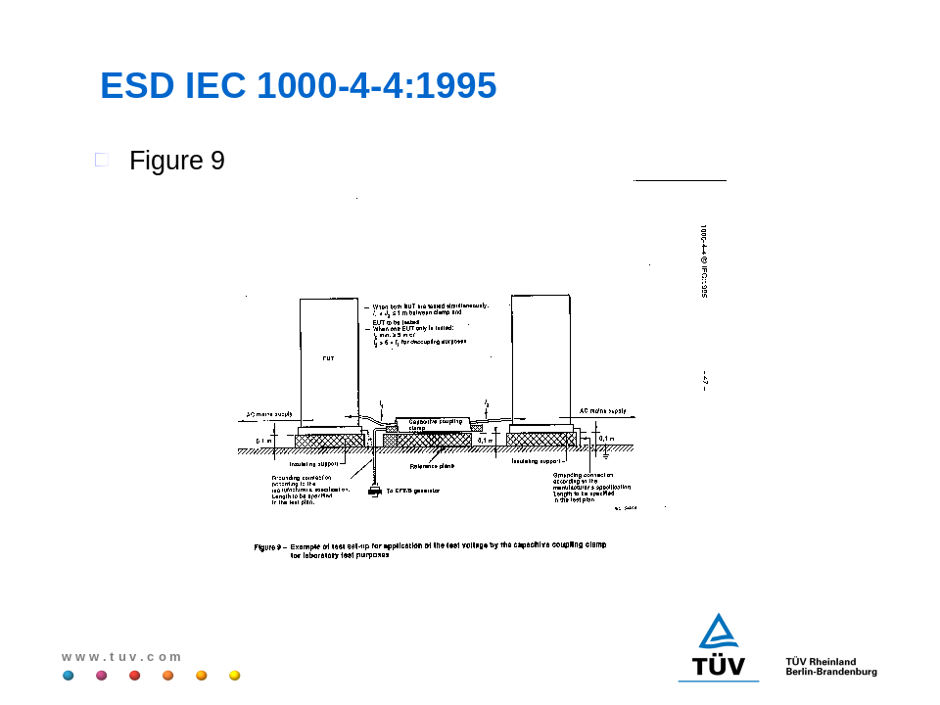
ESD IEC 1000-4-4:1995
Figure 10

Slide 28
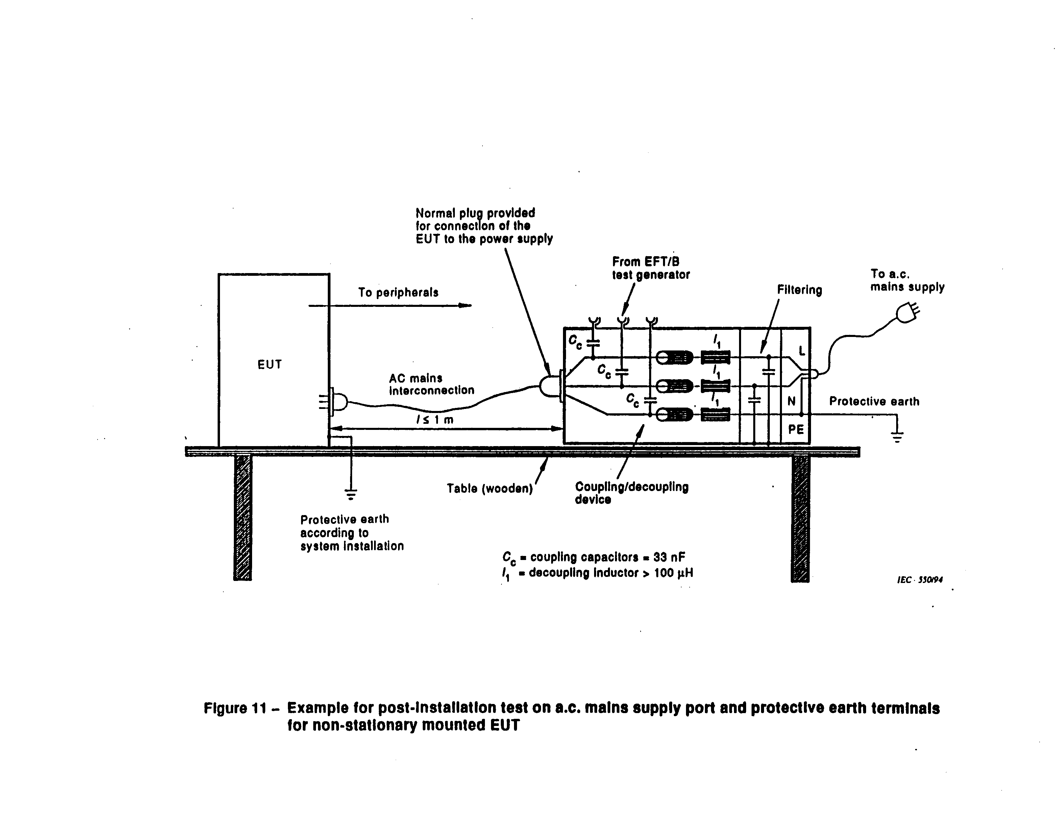
ESD IEC 1000-4-4:1995
Figure 10

Slide 29
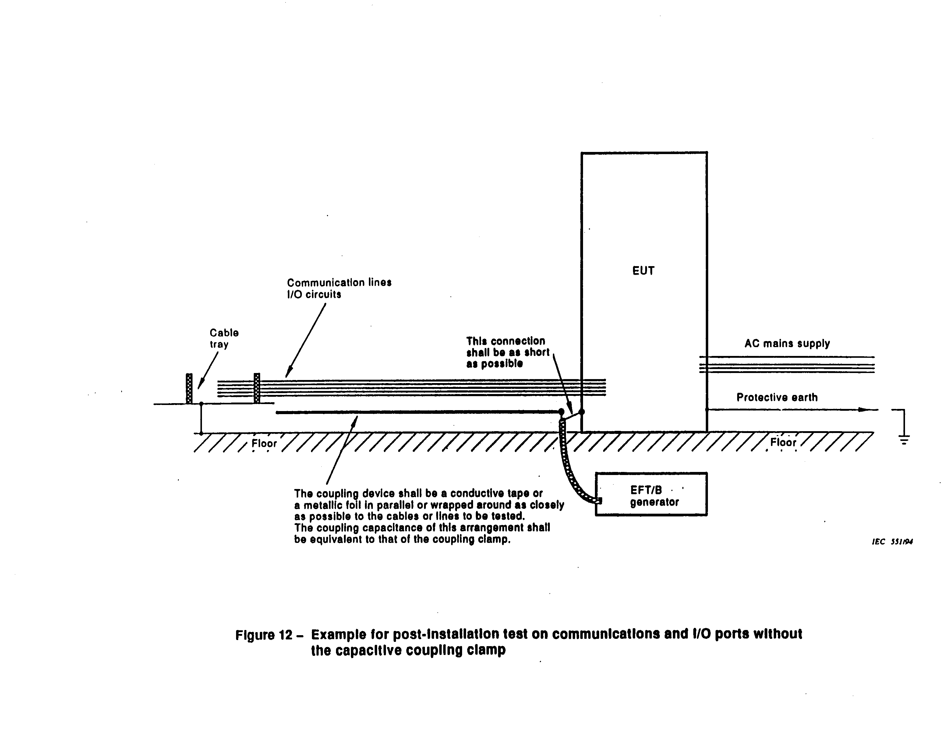
ESD IEC 1000-4-4:1995
Figure 12

